Slide 1
SQL DML 2
Dr. Sonal Dekhane
ITEC 3200

Slide 2
Built-in Functions
Built-in functions to be used in the SELECT clause:
  COUNT
  SUM
  MAX
  MIN
  AVG

Slide 3


COUNT
Find the total number of projects
Where can we find project data?
What tells us how many projects are in the table?
  SELECT COUNT(*) FROM PROJECT;
  SELECT COUNT(*) AS NumOfProjects FROM PROJECT;

Slide 4
More Built-in Functions
Built-in functions cannot be used in WHERE clause
Example:
SELECT ProjectID, MaxHours FROM Project WHERE MaxHours < Avg(MaxHours);

Slide 5
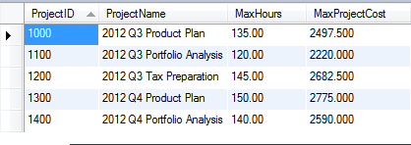
Calculations
Standard mathematical calculations can be done
Use with the WHERE clause
Example:
  For each project in the project table, calculate and display the project cost along with the projectid, projectname and max hours. Project cost is calculated as 18.5*MaxHrs
SELECT ProjectID, ProjectName, MaxHours, (18.5 * MaxHours) AS MaxProjectCost FROM Project;

Slide 6
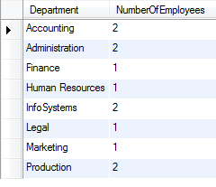
GROUP BY
Clause to group rows by common values
Built-in functions can be applied to groups of rows
Example:
  Find the number of employees in each department
    SELECT Department, Count(*) As NumberOfEmployees FROM Employee GROUP BY Department;

Slide 7
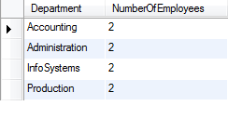
HAVING Clause
Restrict results by applying conditions to the groups formed
  Usually used with group by, when further restrictions require use of built-in functions
Example:
  Display the number of employees in each department for all departments having more than 1 employee
    SELECT Department, Count(*)
    AS NumberOfEmployees
    FROM Employee
    GROUP BY Department
    HAVING Count(*) > 1;

Slide 8

WHERE And GROUP BY
WHERE clause is applied before GROUP BY to avoid ambiguity
  Usually used with group by when restrictions do not need built-in functions
Example
  Find the number of employees in each department. Count only employees whose employee number is less than or equal to 6. Only display departments with 2 or more employees
    SELECT Department, Count(*) AS NumberOfEmployees FROM Employee
    WHERE EmployeeNumber <= 6
    GROUP BY Department
    HAVING Count(*) > 1;

Slide 9
Subqueries
Used to retrieve data from multiple tables when selected columns are from a single table
Example:
  Problem: Display the names of all employees who have worked more than 40 hours on any single assignment.
    Employee name is in Employee table
    Number of hours is in Assignment table
    What is common between the two tables?
      EmployeeNumber

Slide 10
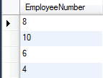
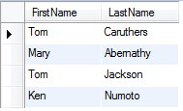
SELECT DISTINCT EmployeeNumber FROM Assignment WHERE HoursWorked > 40;
SELECT FirstName, LastName FROM Employee WHERE EmployeeNumber IN (8,10,6,4);

Slide 11
SELECT FirstName, LastName FROM Employee WHERE EmployeeNumber IN (SELECT DISTINCT EmployeeNumber FROM Assignment WHERE HoursWorked > 40);

Slide 12
Multiple levels of subqueries are allowed
Example:
SELECT FirstName, LastName
FROM Employee
WHERE EmployeeNumber IN
(SELECT DISTINCT EmployeeNumber FROM Assignment
WHERE HoursWorked > 40
AND ProjectID IN
(Select ProjectID
FROM Project
WHERE Department = 'Accounting'));

Slide 13

Results of a subquery come from a single table

Slide 14
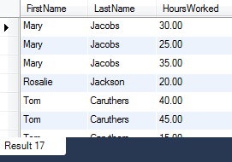
JOIN
If results/columns selected come from more than one table then use Joins (join operator)
Also called inner join
Example
  Display the first name, last name and hours worked for each employee on each assignment.
  SELECT FirstName, LastName, HoursWorked FROM Employee, Assignment WHERE Employee.EmployeeNumber = Assignment.EmployeeNumber;

Slide 15
Alternate Syntax
  SELECT FirstName, LastName, HoursWorked
  FROM Employee INNER JOIN Assignment
  ON Employee.EmployeeNumber = Assignment.EmployeeNumber;

Slide 16
All the other clauses apply
Example:
  Display the first name, last name and hours worked for each employee on each assignment. Sort the results by project id and then by employee number.
      SELECT FirstName, LastName, HoursWorked
      FROM Employee, Assignment
      WHERE Employee.EmployeeNumber = Assignment.EmployeeNumber
      ORDER BY ProjectID, Employee.EmployeeNumber;

Slide 17
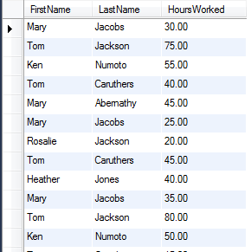

Slide 18
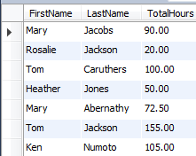
GROUP BY Example
Display the first name, last name and total hours worked for each employee
  SELECT FirstName, LastName, SUM(HoursWorked) AS TotalHoursWorked
  FROM Employee, Assignment
  WHERE Employee.EmployeeNumber = Assignment.EmployeeNumber
  GROUP BY Employee.EmployeeNumber

Slide 19
Using AS to Create Aliases
SELECT FirstName, LastName, SUM(HoursWorked) AS TotalHoursWorked
FROM Employee AS E, Assignment AS A
WHERE E.EmployeeNumber = A.EmployeeNumber
GROUP BY A.EmployeeNumber;

Slide 20
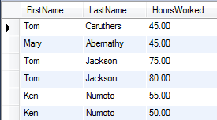
AND Operator
Display the FirstName, LastName and HoursWorked for all Employees who have worked more than 40 hours
  SELECT FirstName, LastName, HoursWorked FROM Employee AS E, Assignment AS A
  WHERE E.EmployeeNumber = A.EmployeeNumber AND HoursWorked > 40;

Slide 21
Join More Than Two Tables
Display projectname, firstname, lastname and hours worked for each employee on each project. Use aliases in the join statement
  Where can all the information be found?
  What are the common columns?
  How to specify more than one conditions?
  SELECT ProjectName, FirstName, LastName, HoursWorked
  FROM Employee AS E, Project AS P, Assignment AS A
  WHERE E.EmployeeNumber = A.EmployeeNumber AND P.ProjectID = A.ProjectID
  ORDER BY P.ProjectID, E.EmployeeNumber;

Slide 22
Modifying Data
Syntax:
  UPDATE TableName
  SET ColumnName = Value
  WHERE ConditionExists
Example:
  UPDATE Employee
  SET Phone = ‘360-287-8810’
  WHERE EmployeeNumber = 11;
EXTREMELY IMPORTANT TO USE THE WHERE CLAUSE
  If WHERE clause is not used all phone numbers in the table will be changed

Slide 23
Changing multiple values
Example:
  UPDATE Employee
  SET Department = ‘Finance’, Phone = ‘360-285-8420’
  WHERE EmployeeNumber = 5;

Slide 24
Deleting Data
Syntax:
  DELETE
  FROM TableName
  WHERE ConditionExists;
WHERE clause is again optional, but use with caution
Remember the ON DELETE Cascade constraint
  Will delete corresponding records in other tables
  ON DELETE NO ACTION constraint will fail a delete command if data dependency exists
Example:
  DELETE
  FROM Project

Slide 25
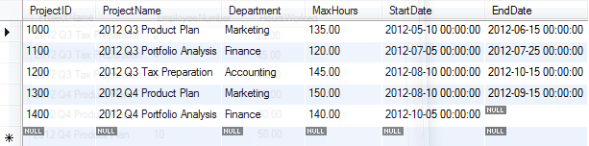
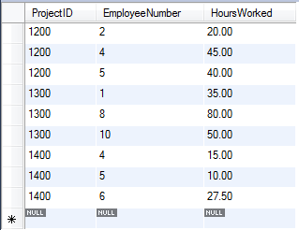
ON DELETE CASCADE Example
DELETE FROM Project WHERE ProjectID = 1500;

Slide 26
ON DELETE NO ACTION Example
DELETE FROM Employee WHERE EmployeeNumber = 1;

Slide 27
SQL DDL
Modifying and deleting tables

Slide 28
Deleting Table
DROP TABLE TableName;
Use with caution!
Will not delete table if values are needed to satisfy referential integrity constraints
  You can drop Assignment table, but not Employee or Project tables until Assignment is dropped

Slide 29
Modify Table
ALTER TABLE TableName
ADD/ALTER/DROP ColumnName DataType
Example:
  ALTER TABLE Employee
  Add Gender Char(6);
Example:
  ALTER TABLE Employee
  ALTER Gender Varchar(6); //changes data type
Example:
  ALTER Table Employee
  Change Phone PhoneNo char(12); //changes column name

Slide 30
Modify Table
Example:
  ALTER TABLE Employee
  DROP COLUMN Gender;
Example:
  ALTER TABLE ASSIGNMENT
  DROP Foreign Key ASSIGN_EMP_FK; //This is where naming constraints has an advantage
    Can also add constraints

Slide 31
Practice
Change the OfficeNumber of Accounting department to BLDG01-300. Show the results by running a Select * statement.
Change the column name MaxHours in Project table to Maximum Hours. Show the results by running a Select * statement.
(ONLY WRITE THE STATEMENT. DO NOT RUN IT!)Drop constraint ASSIGN_PROJ_FK on the Assignment table.

